Slide 1

FHIR Update
NICTIZ
27-Nov 2014
Notes:
Why we did FHIR
- embedded in the v3 process
- increasing recognition of problems (RIM consistency not supported in real world, doesn’t always standardise the right thing, too hard anyway – no benefits / too much cost)
- CDA ok (simplicity / stability, but too simple, and wrong paradigm for what is coming, Australian implementation experience)
- Needed something new or HL7 would cease to become relevant. Needed a different kind of focus: implementers. Needed a new direction on IP as well
What is FHIR
- manifesto briefly
Did it work?
- our progress – and putting a bare DSTU out
- much engagement, specially from vendors, also regulatory (riding the wave is worse that flogging a dead body)
- FHIR design is harder than v3 – but not the tools, it’s in the engagement
- ate v3 from inside out, and symptoms starting to appear that the same is happening to CDA
- impact of license / ethos
Where are we up to?
- preparing a new DSTU 2. This is a real DSTU
- input based on user experience.
- scaling up the community engagement
- US regulatory process
What impacts for NICTIZ
- difficult position
- current path, increasing divergence from the market, perceived as dead. (perception is reality?).
- new path, not stable, still a couple of key questions to be resolved (hype curve)
- Protect your investment – but which investment? Interoperability is all about the people
- The FHIR ethos: iterative steps, testing with real world implementations.

Slide 2
FHIR Development Progress
July 2011 – Conception
Aug/Sept 2012 – First Draft Ballot
Sept 2012 – First Connectathon
Aug/Sept 2013 – First DSTU ballot DSTU = Draft Standard For Trial Use
January 2014 – DSTU finalised
~June 2015 – 2nd DSTU
Late 2016? – Normative Version

Slide 3
FHIR Manifesto
Focus on Implementers
Target support for common scenarios
Leverage cross-industry web technologies
Human readability as base level of interoperability
Make content freely available
Support multiple paradigms & architectures
Demonstrate best practice governance

Slide 4
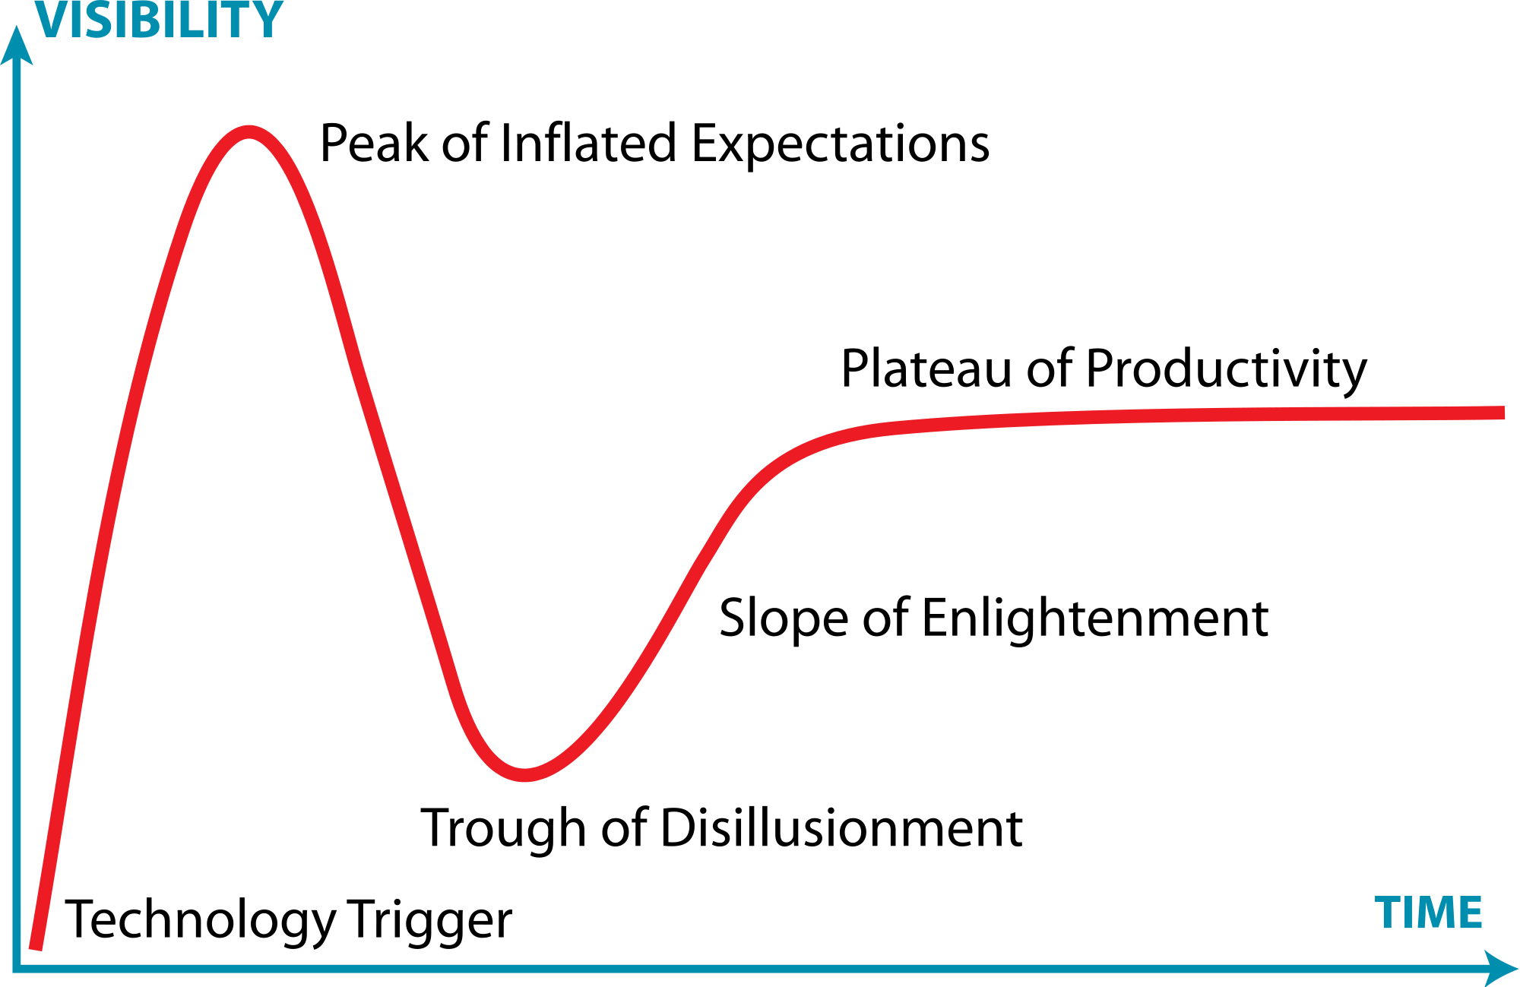

Slide 5
FHIR Manifesto
Focus on Implementers
Target support for common scenarios
Leverage cross-industry web technologies
Human readability as base level of interoperability
Make content freely available
Support multiple paradigms & architectures
Demonstrate best practice governance

